Slide 1
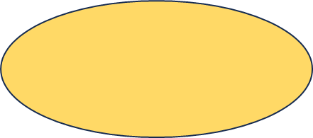


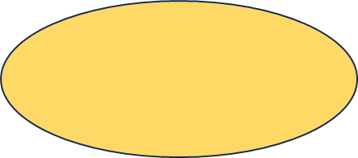
Harry T. Zarate
Computer Programming 1
IT1R15
Activity #2 Create flowchart for the pseudocode example 1 and 2.
Example 1:
Flowchart1
START
END
Read n1
Read n2
Sum= n1+n2
Print sum

Slide 2
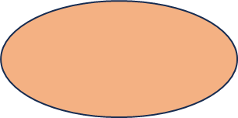

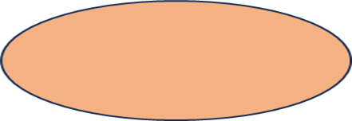


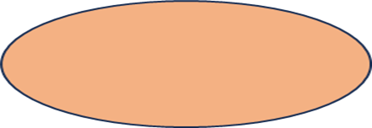


Example 2
Flowchart2
START
Initialize variable
counter=2
In the counter
<=30?
Initialize variable
counter=0
Loop start
(while loop)
Add the counter
To the sum
Add 2 to the counter
Is the counter
=30?
Print the sum
END

Slide 3
2. Create pseudocode for the flowchart example 1,2,3 and 4
Example 1:
1. Start
2. Read Length (L): Prompt the user to enter the length of the
rectangle and store it in variable L.
3. Read Width (W): Prompt the user to enter the width of the
rectangle and store it to variable W.
4. Calculate area:
area = L * W: Calculate the area of the rectangle (Area =
Length * Width).
5. Calculate perimeter:
Perimeter = 2 * (L + W): Calculate the perimeter of the
rectangle (Perimeter = 2 * (Length + Width)
6. Display area:
Print “Area: “ + area: Display the calculated area.
7. Display perimeter:
Print “Perimeter: “ + perimeter: Display the calculated
perimeter.
8. End

Slide 4
Example 2:
1. Start
2. Prompt user to input Salary
3. Prompt user to input Overtime hours
4. Calculate Total_Sal as:-Set Total_Sal = Salary + Overtime
5. Display “Total Salary: “ followed by the value of Total_Sal
6. End

Slide 5
Example 3:
1. Start
2.Prompt user to input Balance
3. Read Balance
4. Prompt user to input Transaction
5. Read Transaction
6. Set Balance = Balance + Transaction
7. If Transaction is not equal to 0, then:
a. Display “Transaction completed. Final Balance: “ followed
by the value of Balance
8. If Transaction is equal to 0, then:a. Display “Transaction
completed. Final Balance: “ followed
by the value of Balance
9. End

Slide 6
Example 4:
1. Start
2. Prompt user to input Amount
3. Read Amount
4. If Amount is greater than or equal to 1000, then:
a. Set Donation = 0
6. Display “Donation Amount: “ followed by the value of
Donation
7. End

Slide 7





3. Create a pseudocode and flowchart of Caesar cipher
START
INPUT SHIFT VALUE
INITIALIZE CIPHER TEXT
PSEUDOCODE FOR CAESAR CIPHER:
CAESAR CIPHER
1. Start
2. Prompt user to enter a shift value (integer)
3. Prompt user to enter a shift value (integer)
4. Initialize an empty string variable CipherText
5. For each character (char) in the plaintext:
a. If the character is a letter (A-Z or a-z):
i. Shift the character by the shift value (use modulo to
handle wraparound)
ii. Append the shifted character to CipherText
b. Display CipherText as the encrypted message
7. End
IS THE CHARACTER A LETTER
FOR EACH CHARACTER IN PLAIN TEXT
SHIFT THE CHARACTER
APPEND TO CIPHERTEXT
END OF LOOP
DISPLAY CIPHER TEXT
END

